Slide 1

Site Reliability Engineering

Slide 2






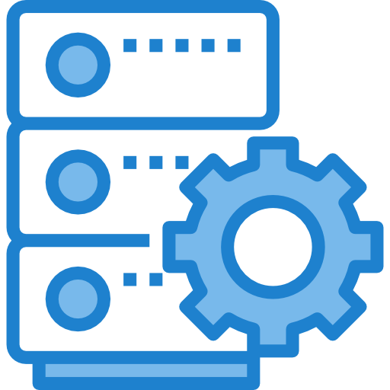

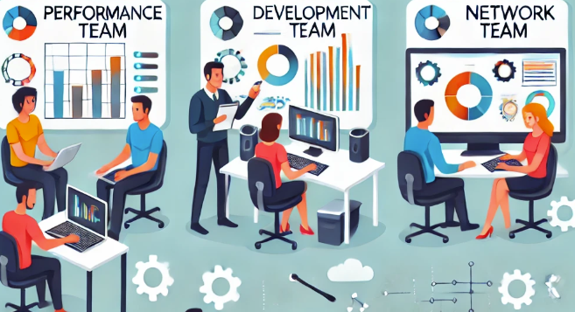


New Features
Customer
Developer
App Server
Web Server
Ops Team

Slide 3
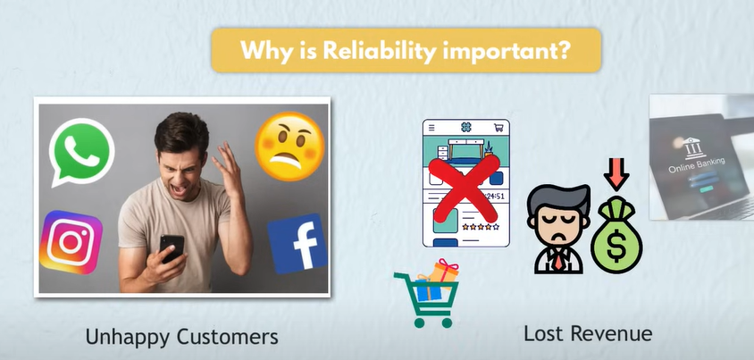
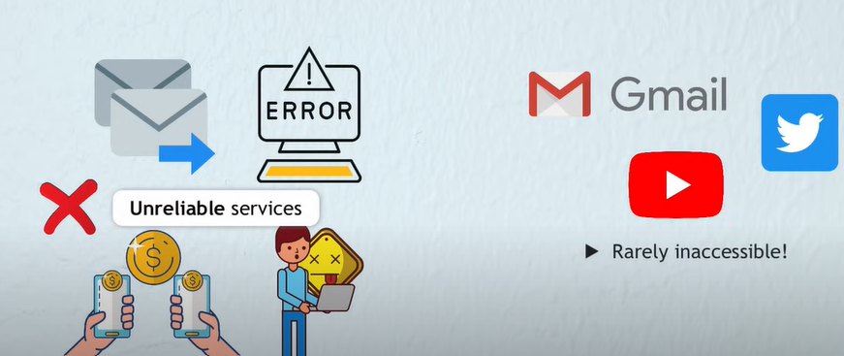

Slide 4
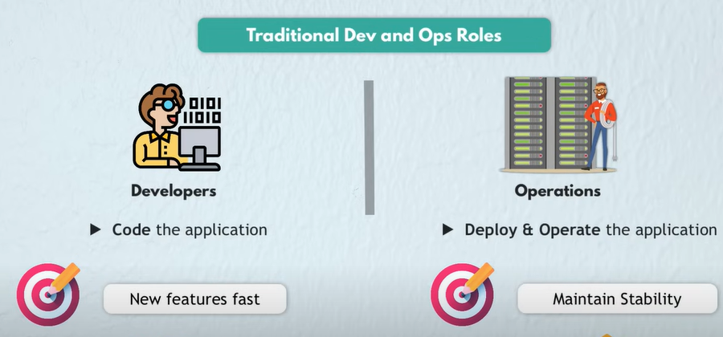

Slide 5
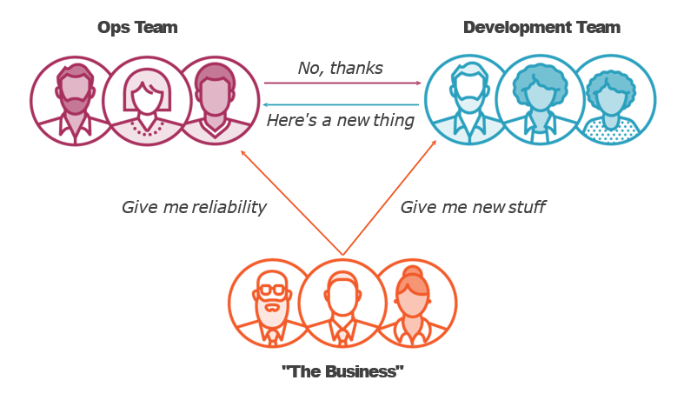
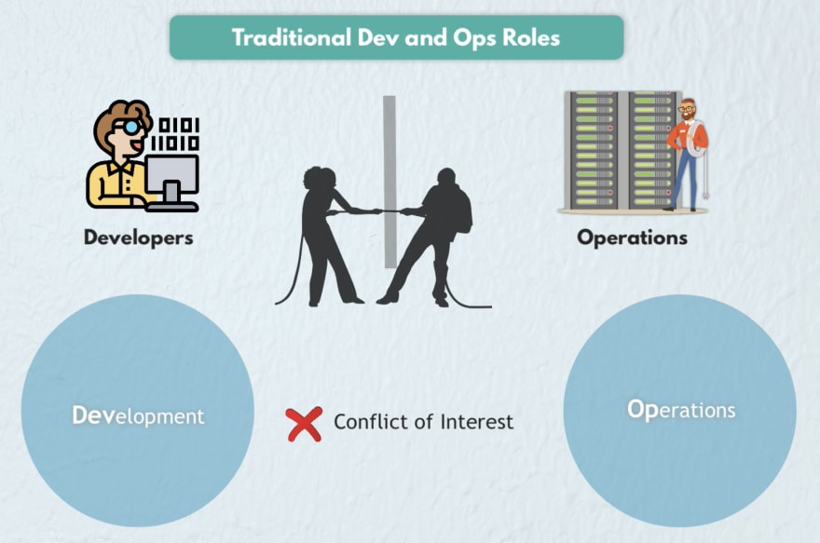

Slide 6





Understanding the Challenges in Traditional IT Operations
Siloed Teams with Conflicting Priorities
Constant Firefighting During Incidents
Repetitive Manual Tasks
Lack of Insight into User Experience
Manual Processes and Toil
Misalignment between development and operations teams can create tension, slowing down releases and affecting system stability.
Spending hours on manual tasks like restarting servers, running updates, or applying patches can be time-consuming and inefficient.
Challenges in having clear visibility into actual user experiences can result in delayed responses to issues impacting users.
Last-minute firefighting during system breakdowns leads to high Mean Time to Detection (MTTD) and Mean Time to Resolution (MTTR), impacting user experiences.
Heavy reliance on manual processes for deployments, incident management, and troubleshooting can lead to errors, lengthy downtimes, and scalability challenges.

Slide 7


The Birth of SRE at Google
What is site reliability engineering?
Site reliability engineering (SRE) is the practice of applying software engineering principles to operations and infrastructure processes to help organizations create highly reliable and scalable software systems. As a discipline, SRE focuses on improving software system reliability across key categories including availability, performance, latency, efficiency, capacity, and incident response.

Slide 8


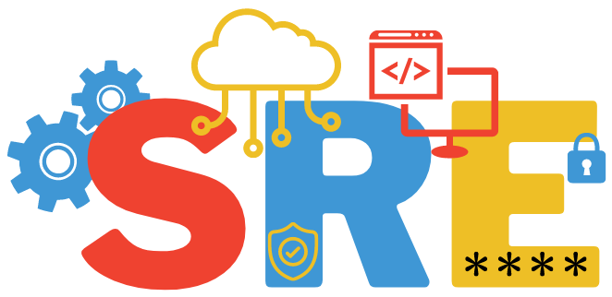


The Turning Point: A New Approach to Reliability
Collaboration
User experience
Uniting developers, operations, and SREs for reliability.
01
02
Measuring performance from the user’s view.
Automation
Error Budget
Automating repetitive tasks to enable strategic work.
03
04
Balancing features and stability with acceptable downtime.

Slide 9

Scenario 1: Repetitive Manual Tasks
How many of you have had to spend hours handling repetitive tasks, like manually restarting servers, running regular updates, or applying patches?
One of SRE’s core principles is reducing ‘toil’—those time-consuming tasks that don’t add much value. Through automation, SRE helps to free up time for more impactful work

Slide 10

Scenario 2: Constant Firefighting During Incidents
How many of you have felt the frustration of last-minute firefighting when a major system breaks down?"—like dealing with a sudden, urgent problem that pops up when you're already overwhelmed with other tasks?
SRE encourages proactive reliability measures, helping teams move away from constant crisis management and focus on preventing issues before they impact users

Slide 11
Scenario 3: Siloed Teams with Conflicting Priorities
How many of you have experienced misalignment between development and operations—where one team’s goals don’t quite match the other’s, or where they’re working in silos?
SRE is all about bridging this gap, with shared goals and collaborative practices that align development and operations toward reliability and user satisfaction

Slide 12
Scenario 4: Lack of Insight into User Experience
How many of you have faced challenges with not having clear visibility into the actual user experience—meaning you find out too late that something’s impacting users?”
SRE prioritizes monitoring metrics that matter to users, helping teams stay in tune with real user experiences and respond proactively.

Slide 13
Correlation Between System Reliability and User Experience
User Experience Metrics: Latency, Uptime, and Error Rates
Why Alignment Between Dev and Ops Matters
Shared SLO: Common Goal
Shared Postmortems
Why Alignment Between Dev and Ops Matters

Slide 14
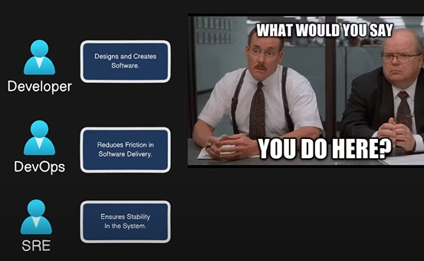

Slide 15
Role | DevOps | SRE
Focus | Fast deployments, efficient infrastructure | Reliability, stability, user experience
Tools | CI/CD, IaC, Monitoring | SLOs, Error Budgets, Automation
Key Responsibilities | Build pipelines, deploy features, manage infrastructure | Maintain SLOs, respond to incidents, automate fixes
Example Task | Roll out a new payment feature safely | Ensure checkout reliability during peak times

Slide 16
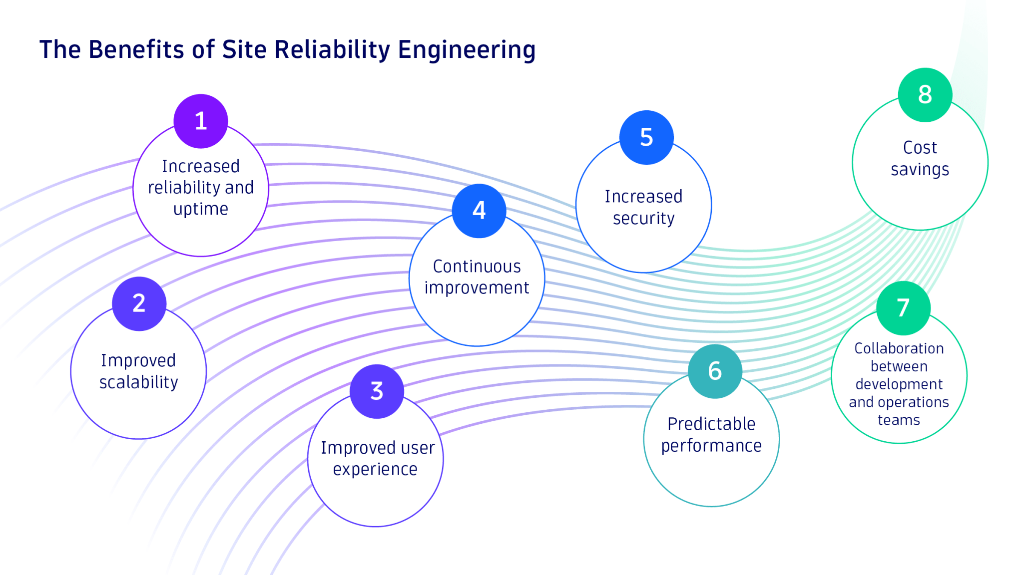

Slide 17
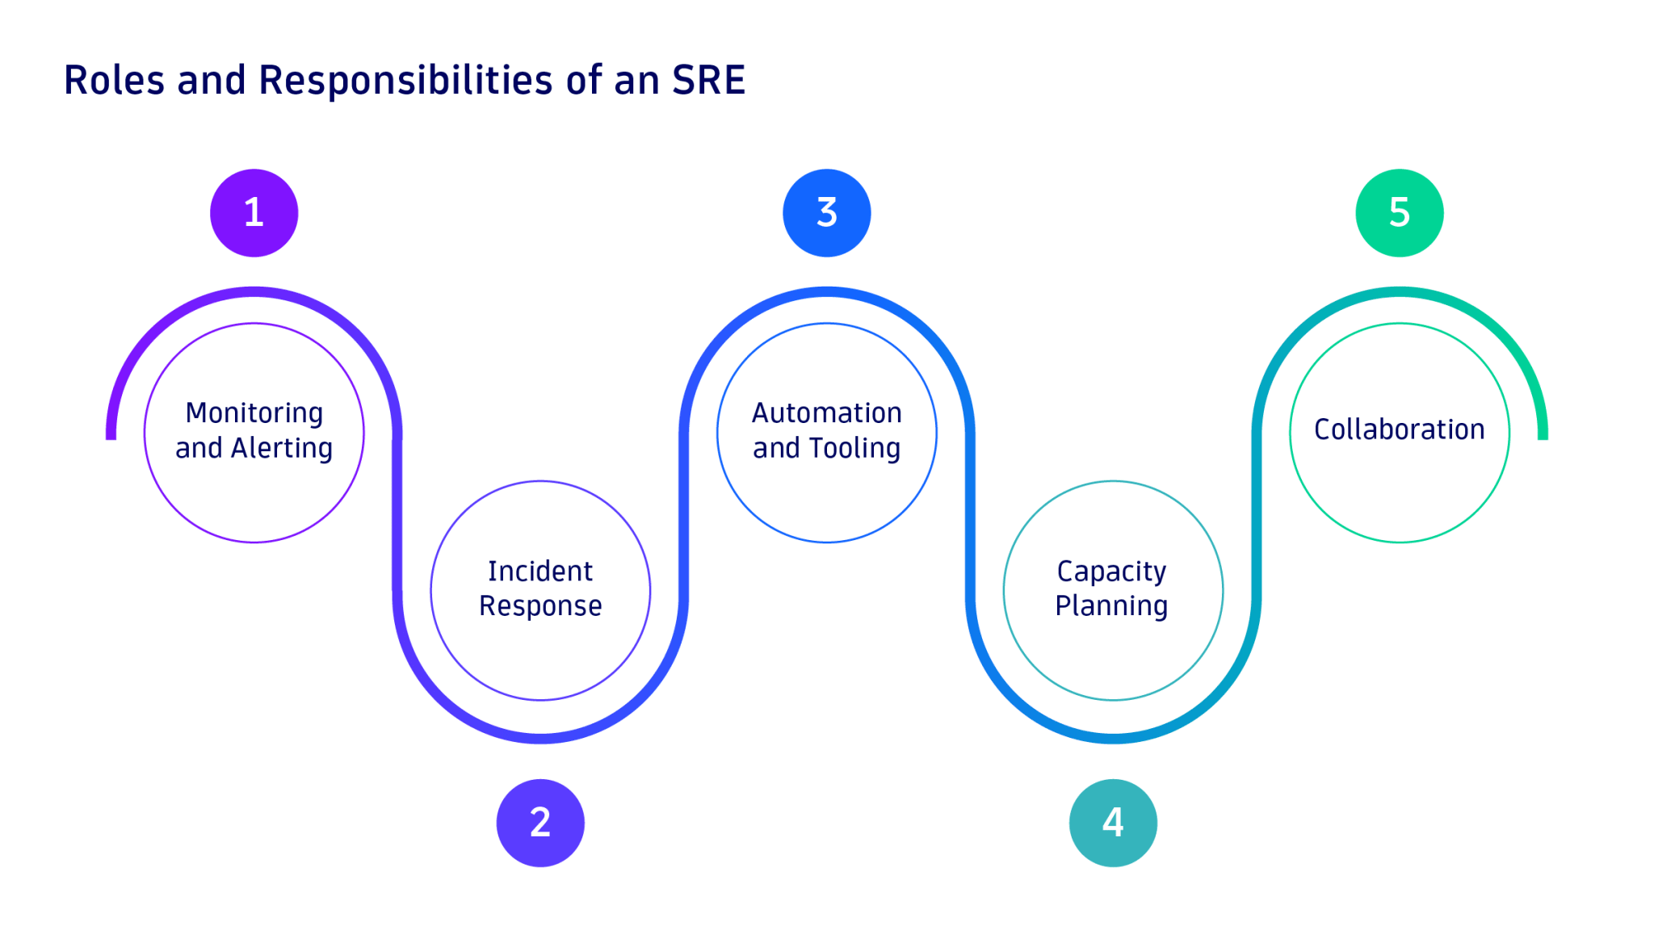

Slide 18
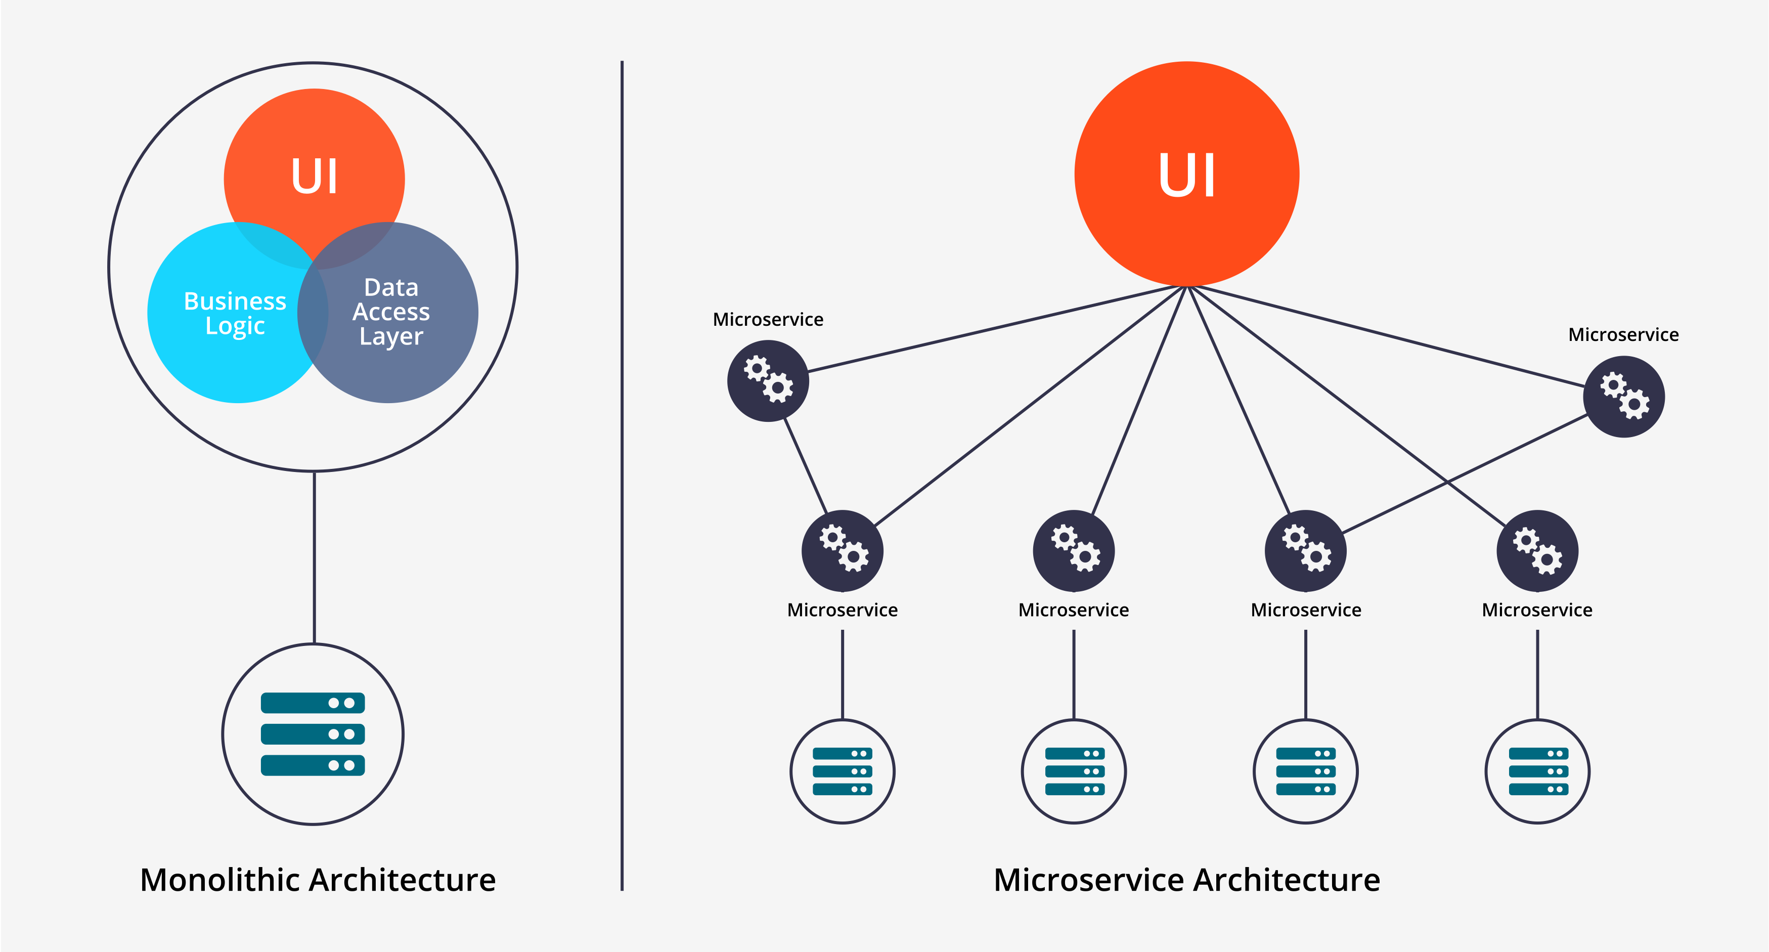
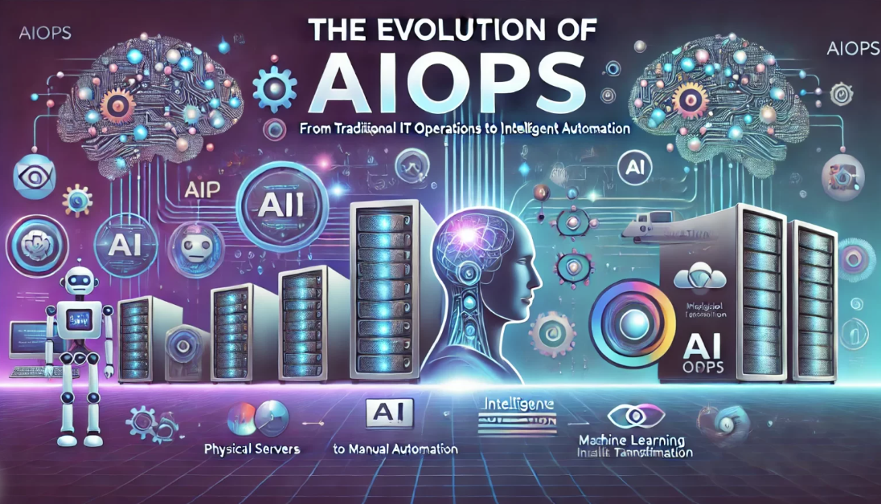

Key Trends and Emerging Methodologies Shaping the Future of SRE
Cloud Native
Automation and AIOps
Observability

Slide 19
